Slide 1
INFO 250 Information Visualization
Week 10A: Storytelling in visualization

Slide 2
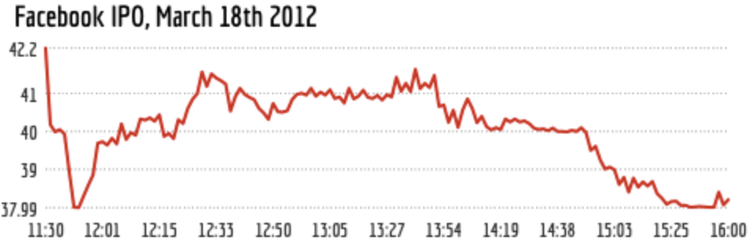
What do you think this graph means?

Slide 3
Answer
Notes:
This is a simple graph that does not require too much background info, and thus other help information. But some people may not really know what IPO is, depending on where you want to publish it.

Slide 4
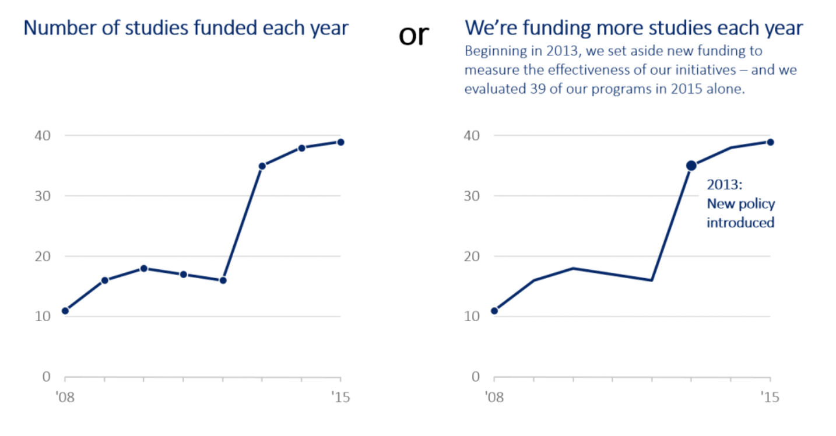
Attention guiding function of titles and annotations
Notes:
Supposed that we are looking at the graph as a final product, what information do you think is needed to understand the graph? “we” and “policy”

Slide 5
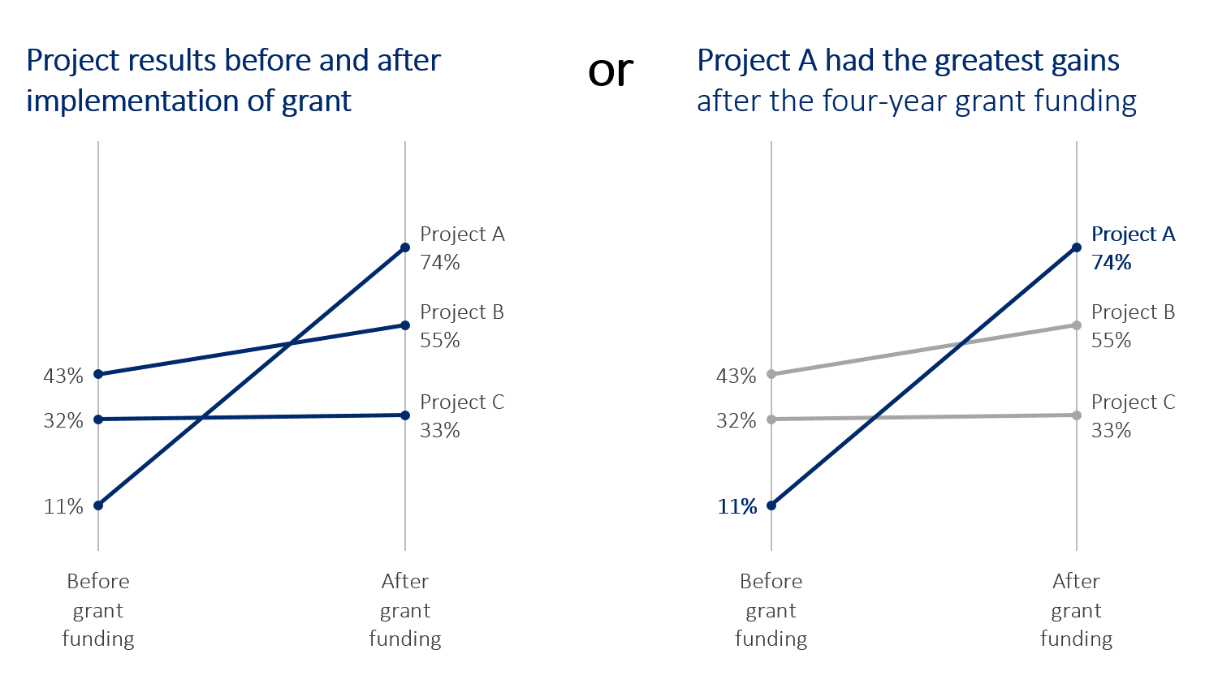
Title as attention guidance

Slide 6
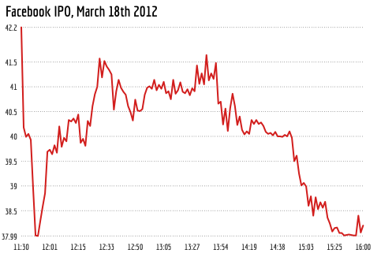
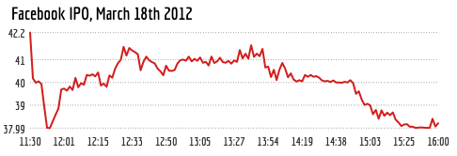
Aspect Ratio
A line chart is the most readable when the slopes average to 45 degrees.

Slide 7
Storytelling
What is a story?
Why is story important?
What does storytelling mean for InfoVis?

Slide 8
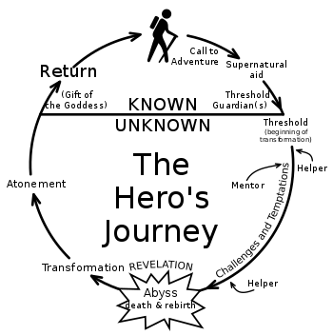
What is a story? (I)
Notes:
haruki murakami
Lotr: Frodo, gandaulf both died; Gollum; undying lands

Slide 9
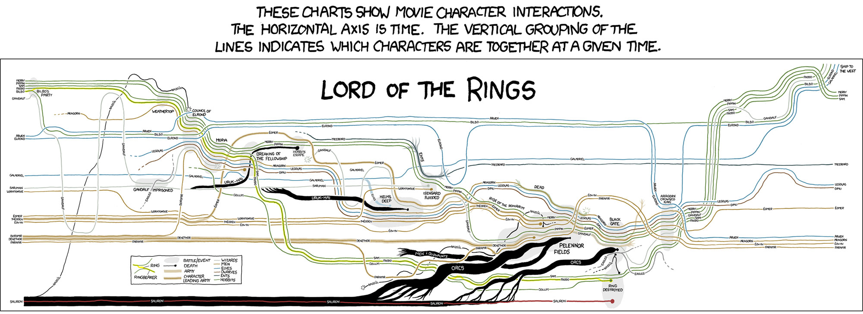
Notes:
Sankey diagram; midland

Slide 10
What is a story?
Who is in the story?
What has happened? What are the results?
Where is this taking place?
When did it happen (time of day, day, month, year)?
Why did this event take place? Why is this important in the big picture?

Slide 11
What makes a good story?
Compelling: A clear and engaging plot that keeps the reader interested.
Well-developed characters: Complex, interesting, believable, with realistic motivations and flaws.
Emotional resonance: A good story should evoke strong emotions in the reader, whether it's through humor, drama, suspense, or other means.
Meaningful themes: Resonate with the reader and offer insight into the human experience.
Authenticity: The story should feel authentic and true to life, realistic.
Surprise and originality: Unexpected twists and turns that keep the reader guessing, and it should offer something fresh and original that hasn't been seen before.
Consistency: The characters and events should make sense within the context of the story.
Memorable: A good story should leave a lasting impression on the reader, with characters and scenes that are unforgettable long after the story has ended.
Keeps the reader engaged and interested ➔ Interesting
Offers insight and new experience ➔ Informative and thought-provoking

Slide 12
Values of Good Stories
Entertaining, help people to escape their daily lives and immerse themselves in a different world, as a source of enjoyment and pleasure.
Educational, help readers to learn about different cultures, perspectives, and ways of life, teach valuable lessons and provide insights into the human experience. Memorable! A higher-level organizing framework.
Inspirational: encourage people to pursue their dreams and overcome obstacles and to see the world in a new light.
Empathy: build empathy and understanding between people from different backgrounds. By exploring the experiences of characters from different walks of life, readers can develop a deeper appreciation for the diversity of the world around them.
Connect people: Help to build community and foster a sense of belonging.

Slide 13
Stories and InfoVis
To make graph effective, we need to think about the visualization as a type of story.
Not everything we have talked about stories can be applied to InfoVis because InfoVis is distinctly different from literary stories.
Because the different media and audience of InfoVis and literary stories, how the narrative is constructed is distinctly different.

Slide 14
5 Ws in InfoVis
Given a dataset, some questions may not make a good sense to ask.
Engaging, interesting, insightful, thought-provoking are good features to achieve as a communication process.

Slide 15
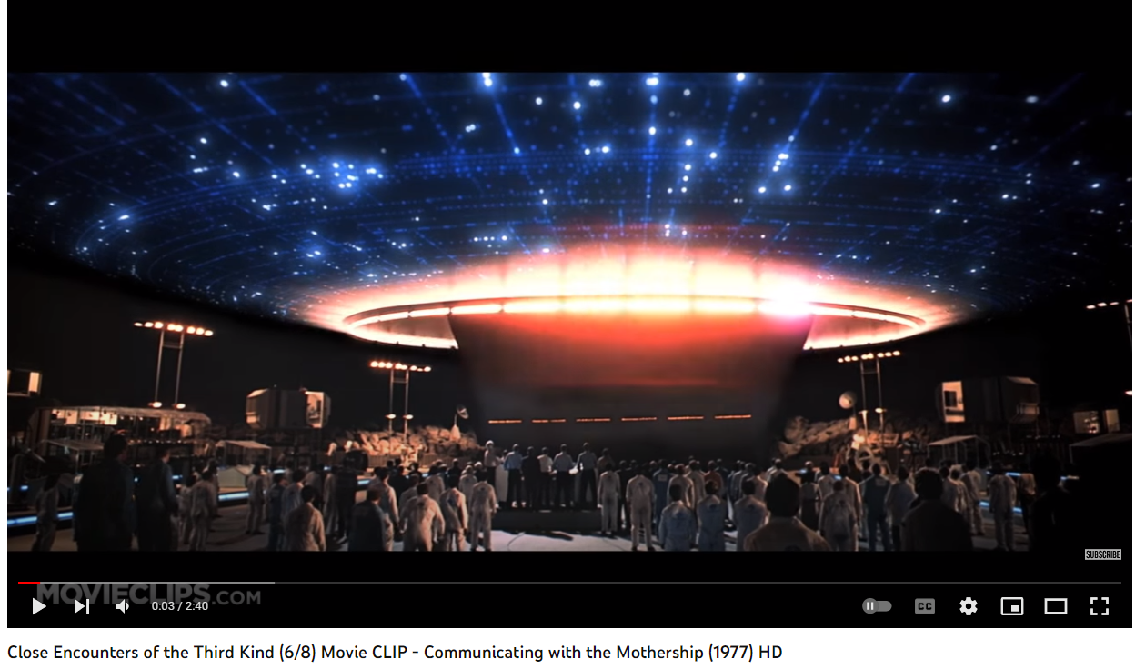
https://youtu.be/S4PYI6TzqYk

